Slide 1
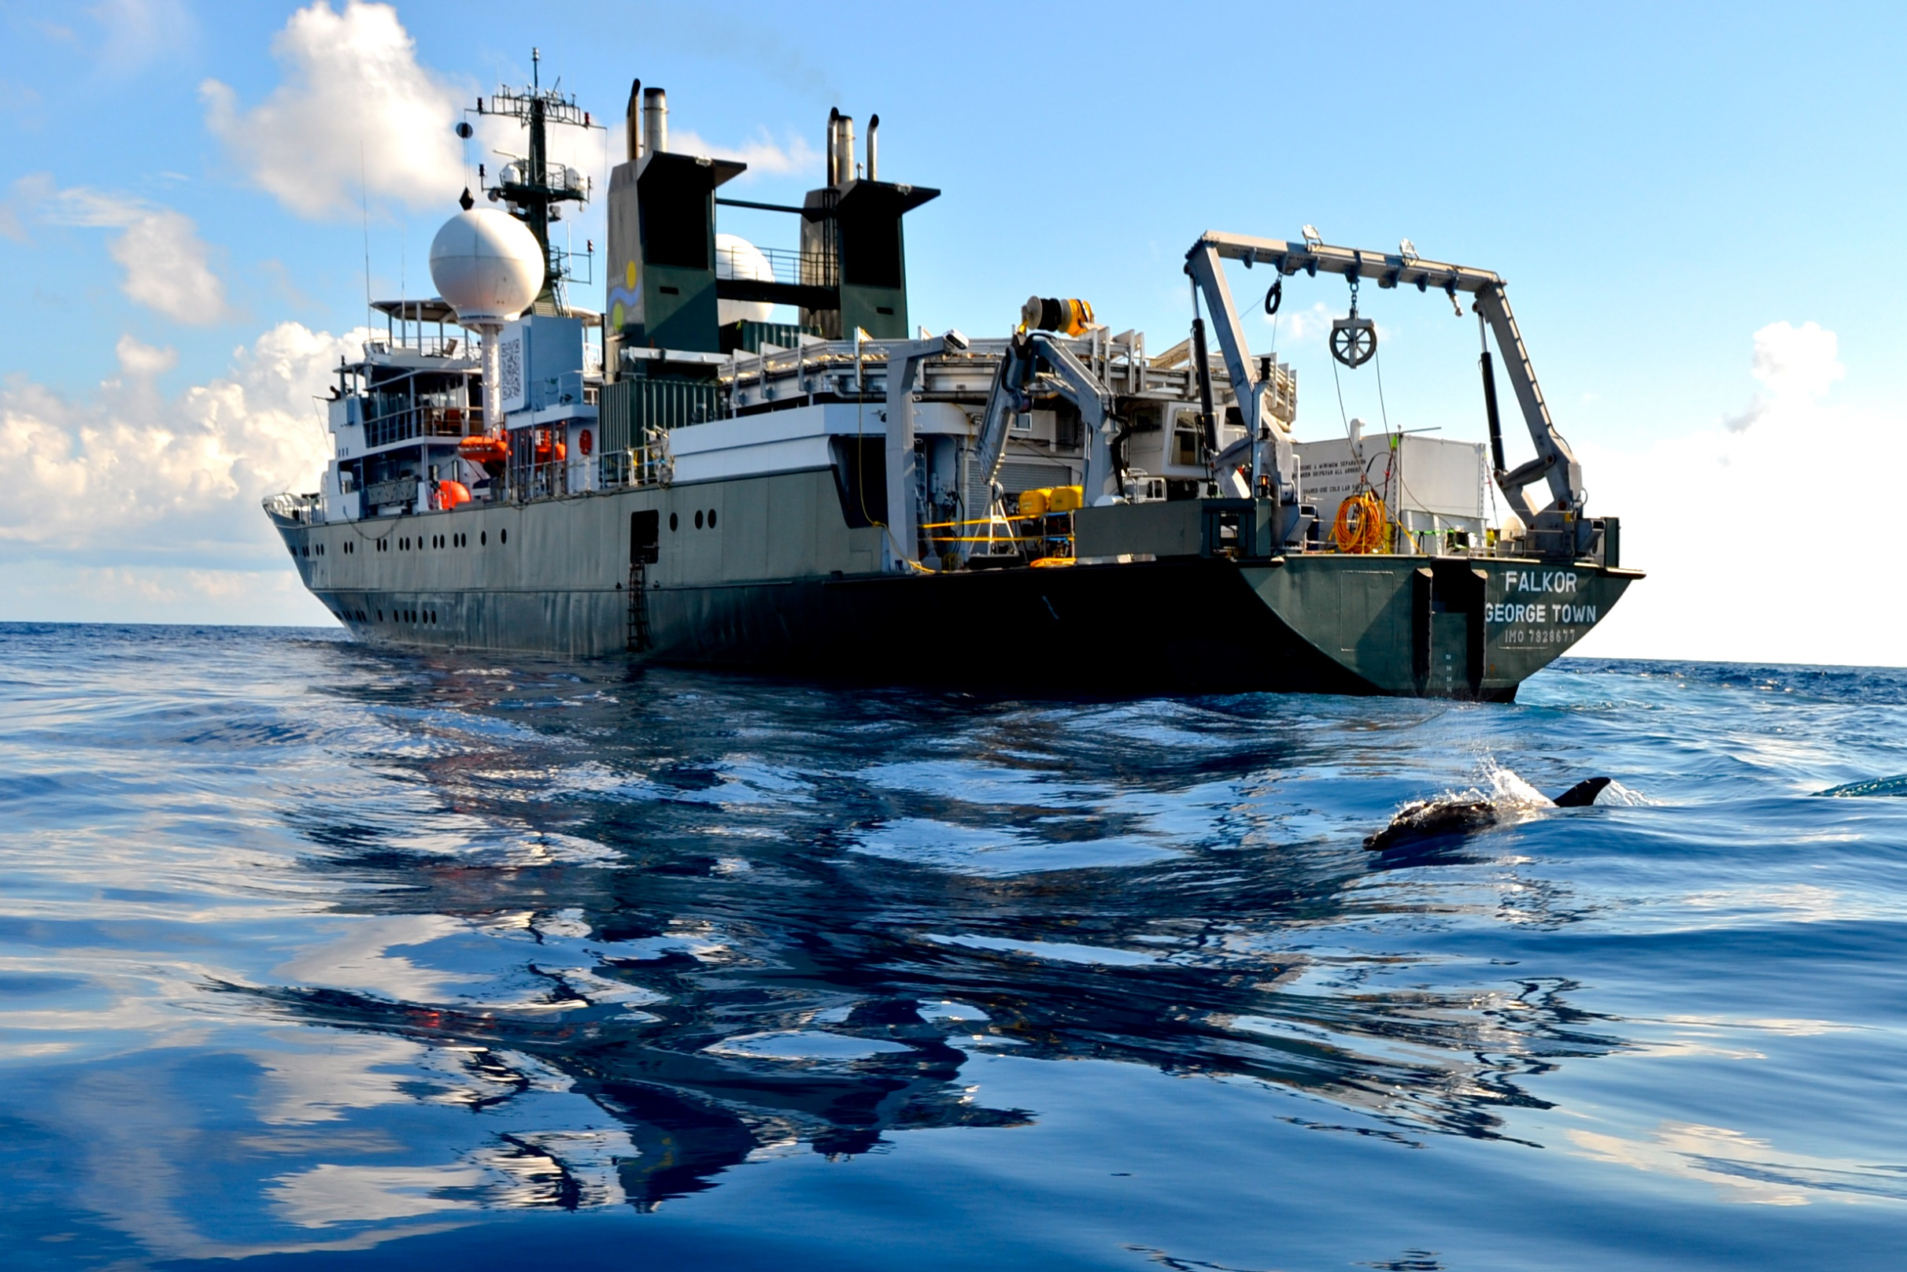
Get prepared!
Deep-Sea Fiji Live Dive on- board RV Falkor

Slide 2
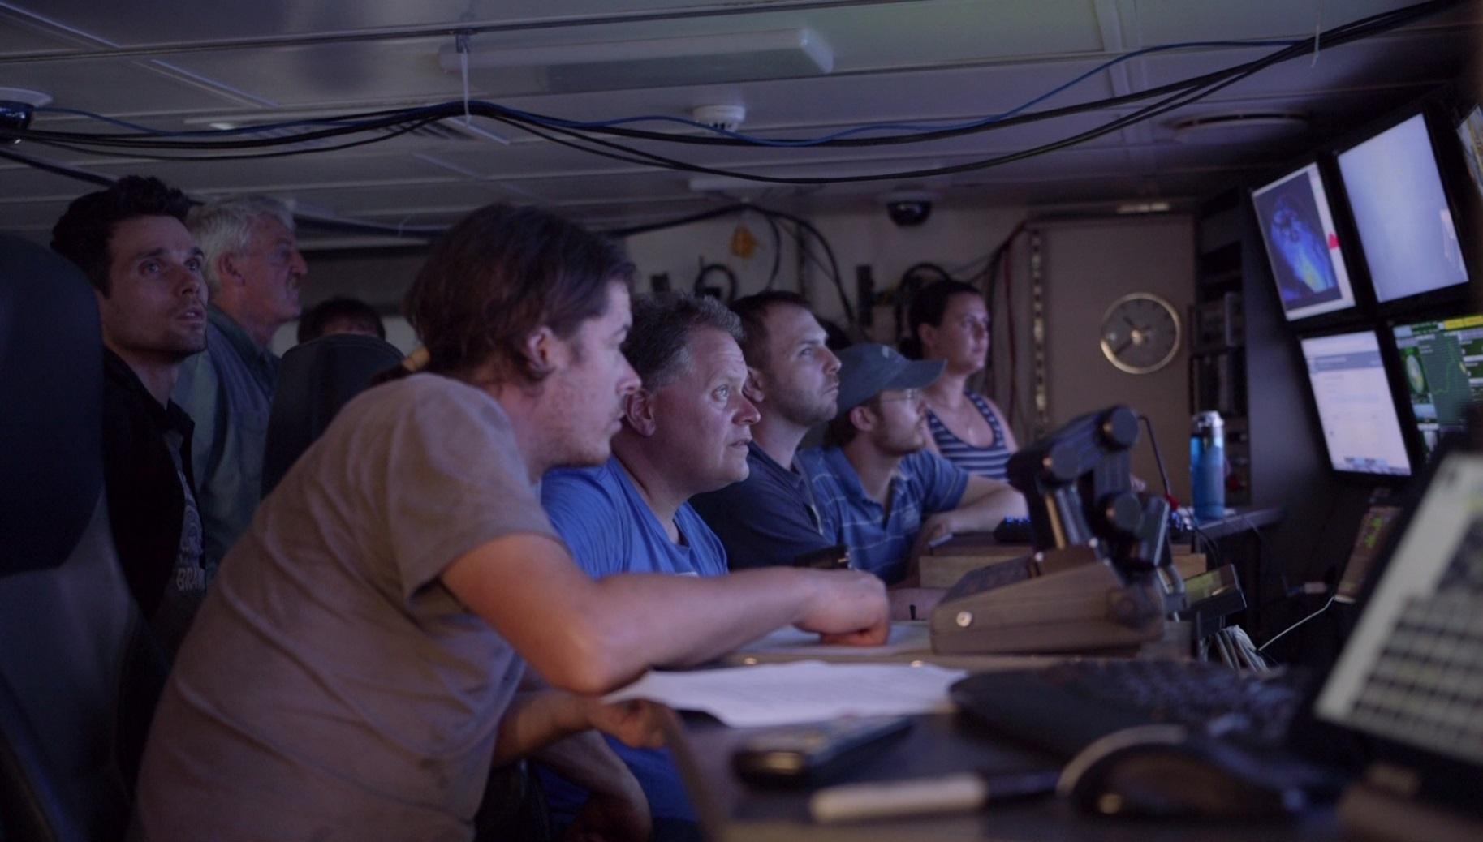
April 29th: a deep dive awaits you!
Aboard the Schmidt Ocean Institute’s research vessel Falkor,
the interdisciplinary team is already in action…
The cruise is led by:
Dr. Charles Fisher, Pennsylvania State University
and
Dr. Peter Girguis, Harvard University
and aims to explore the mysterious seafloor of hydrothermal vent fields.

Slide 3
Prepare your DEEP SEA LOG
Before
I know that:
I wonder if:
I hope that:
After
I learned:
My favorite part was:
I want to know more about:

Slide 4
Where exactly will we dive?
HERE!
Fiji
Australia
New Zealand
Credit Dr Vicki Ferrini and GeoMapApp

Slide 5
How deep is the ocean?
According to NOAA the
average depth is 3.68 Km
https://www.youtube.com/watch?v=d7KtarElq0A

Slide 6
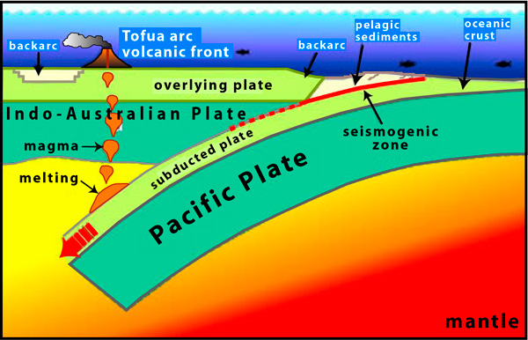
Why dive here?
SUBDUCTION ZONE
Definition: places on Earth where one tectonic plate is forced underneath another plate.
Source: oceanexplorer.noaa.gov
IN BRIEF
Hydrothermal vents are the result of seawater percolating down through cracks in the ocean crust near to plate boundaries.
The cold seawater is heated by hot magma and reemerges to form the vents.
Seawater in hydrothermal vents may reach temperatures of more than 340°C (700°F).
Hot seawater in hydrothermal vents does not boil because of the extreme pressure at the depths where the vents are formed.
http://oceanservice.noaa.gov

Slide 7
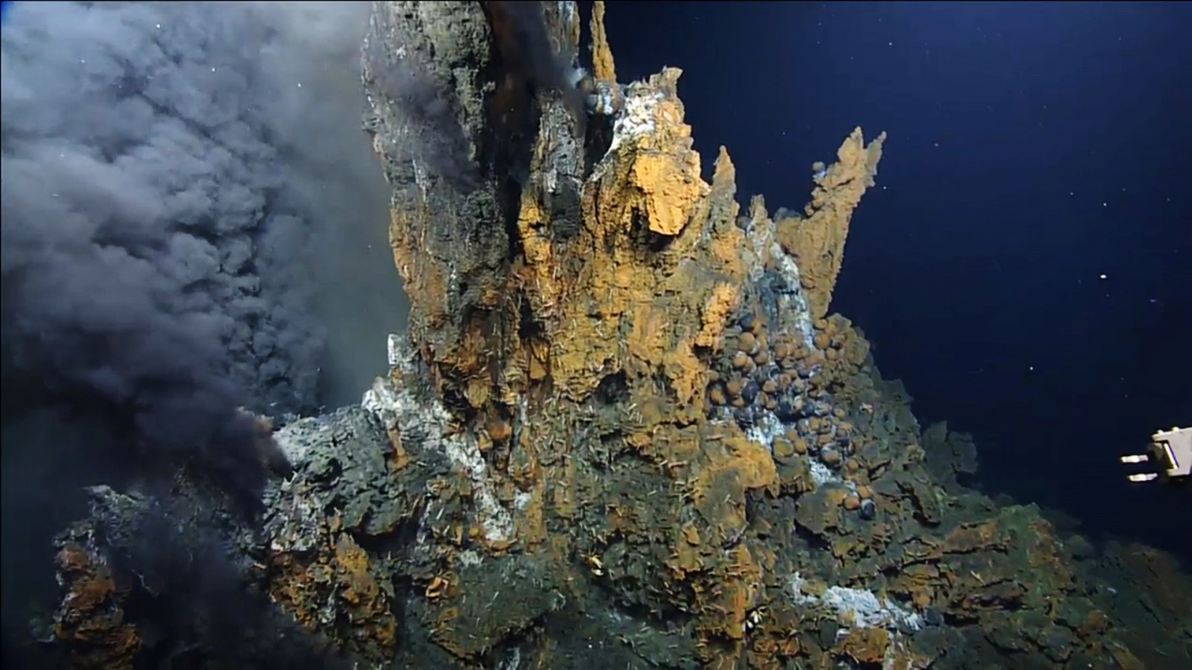
What kind of environment will we find?
HYDROTHERMAL VENT
Definition:
Underwater volcanoes at spreading ridges and convergent plate boundaries can produce hot springs known as hydrothermal vents.
The vent emits particle-laden fluids. The particles are mostly fine-grained sulfide minerals formed when the hot hydrothermal fluids mix with near-freezing seawater. These minerals solidify as they cool, forming chimney-like structures. (Source: NOAA)
Schmidt Ocean Institute
At first glance, it seems hostile!
No sunlight, less oxygen, high pressure, high acidity, big temperature changes…

Slide 8
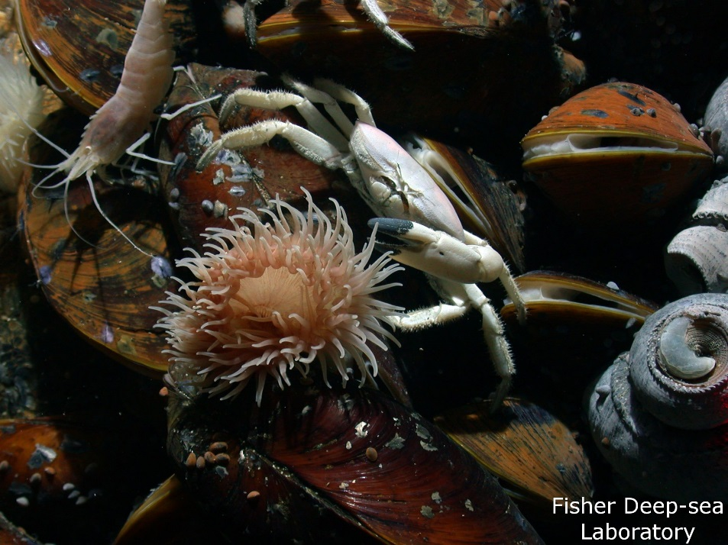
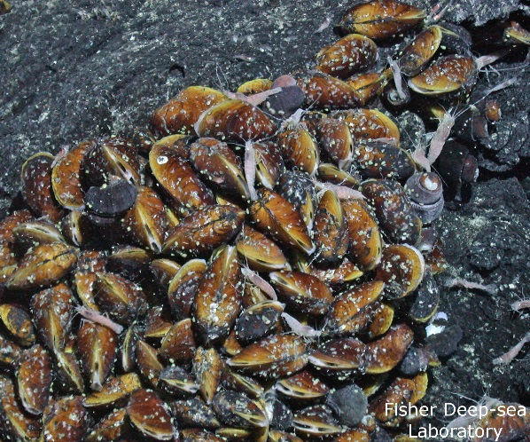
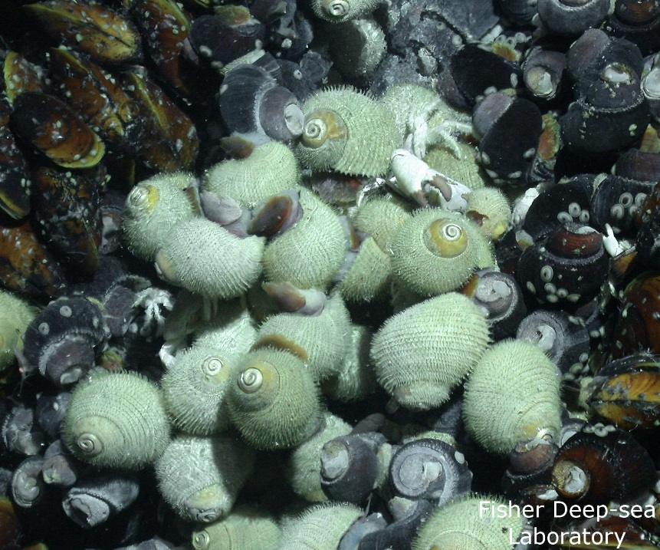
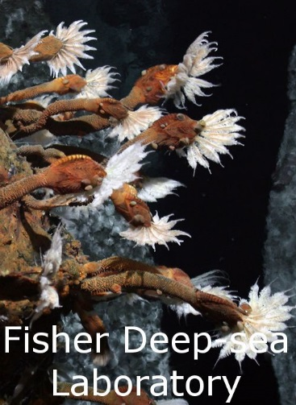
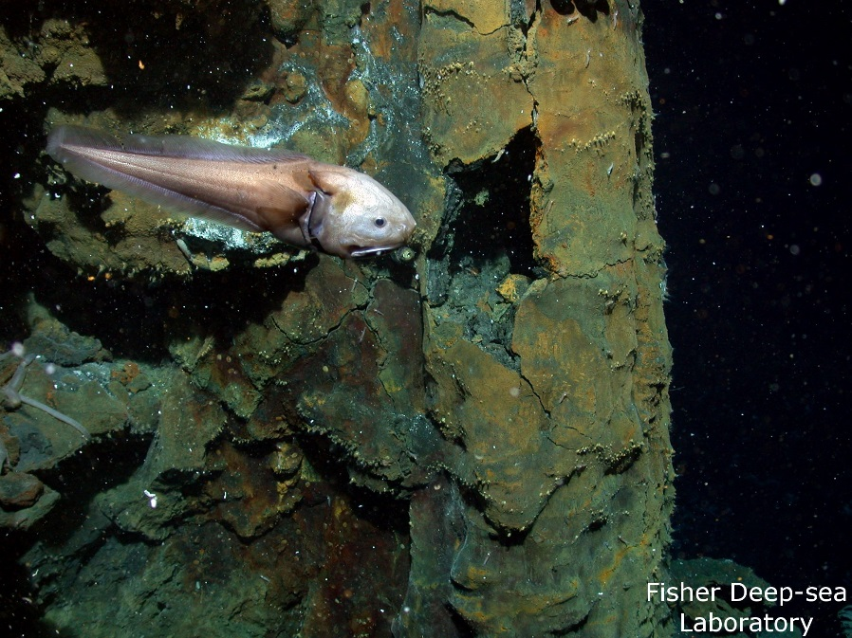
What lives there?
1.
2.
3.
4.
5.
Crabs, mussels, shrimps, anemones, limpets and snails
Mussels, limpets, shrimp and snails
Hairy snails, smooth snails, crabs, mussels and limpets
Stalked barnacles and limpets
Fish!

Slide 9
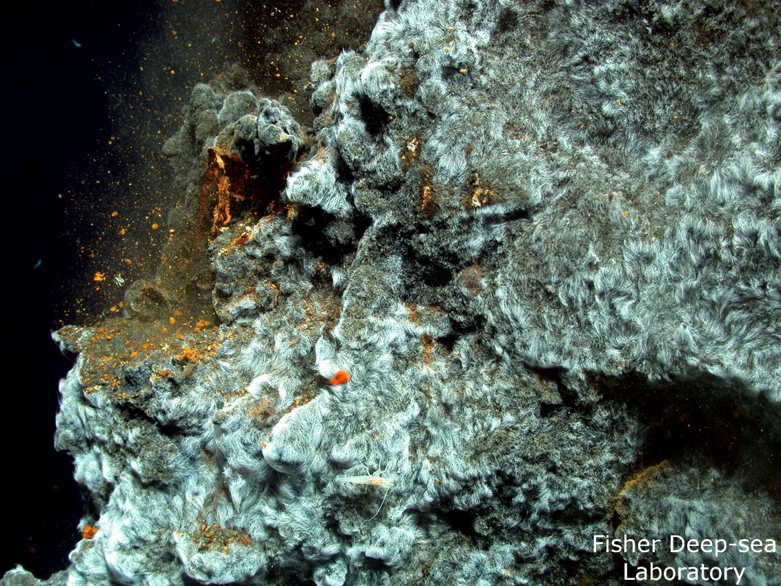
How can animals live there?
Microbial mat
Did you know?... This type of community is where life on Earth is thought to have started...
Unlike most biological communities which rely on sunlight,
this food web relies on tiny chemosynthetic bacteria.

Slide 10
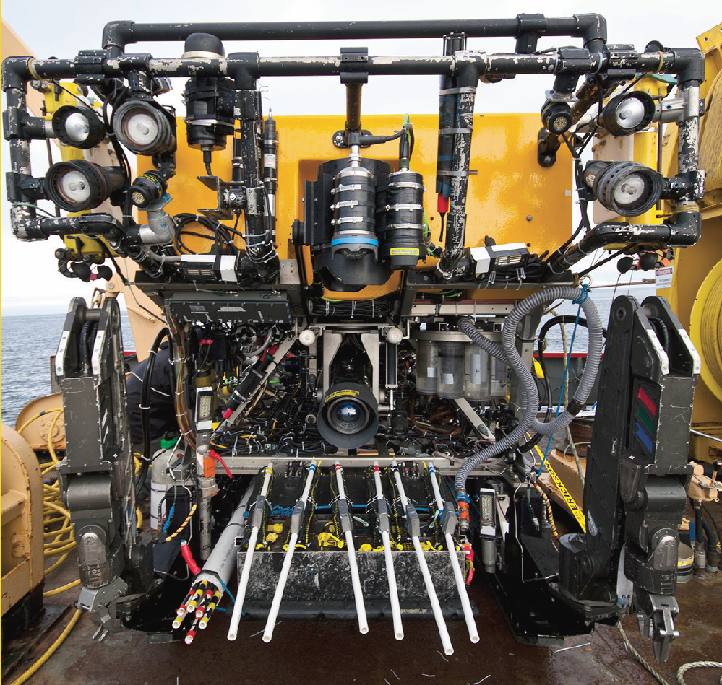
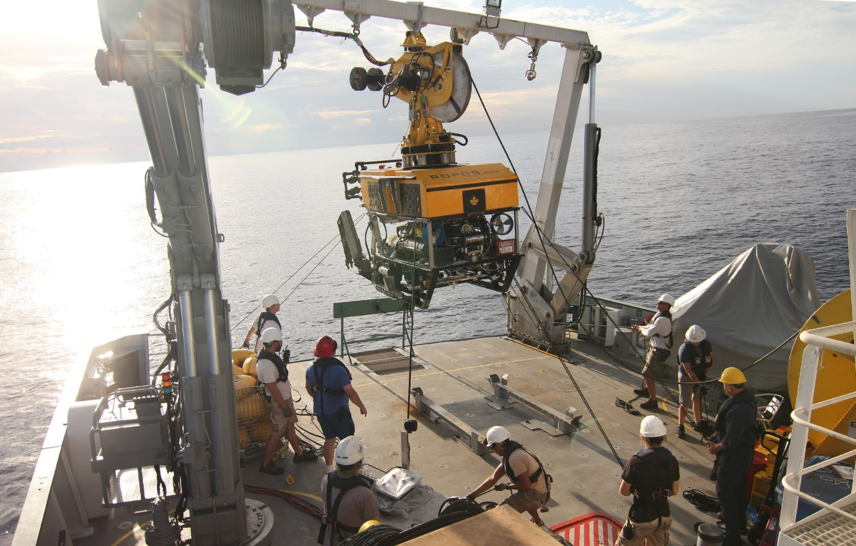
The challenge is getting there!
http://www.ropos.com
Front view of the Remotely Operated Platform For Ocean Sciences (ROPOS)
Launching ROPOS from RV Falkor near Fiji. ROPOS enables images and samples to be taken from the deep

Slide 11
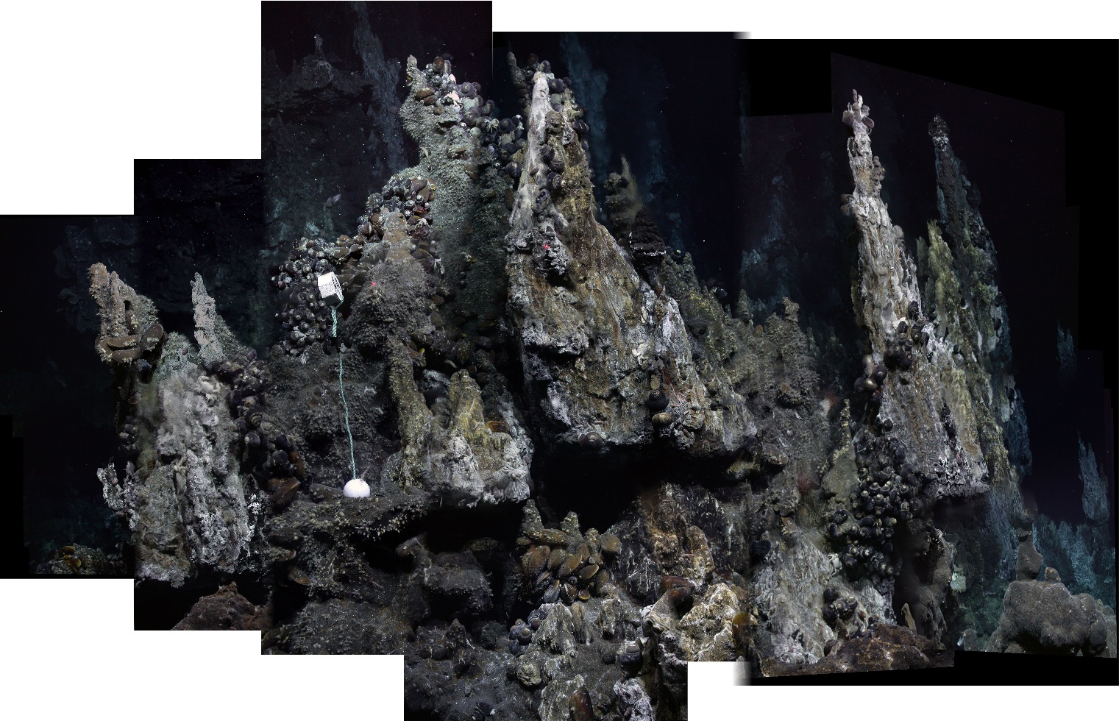
Why are we going there?
« To gain a better understanding of this extreme yet delicate deep sea ecosystem »
High resolution 2D and 3D photo mosaicing
Seafloor mapping surveys
To study deep-sea species

Slide 12
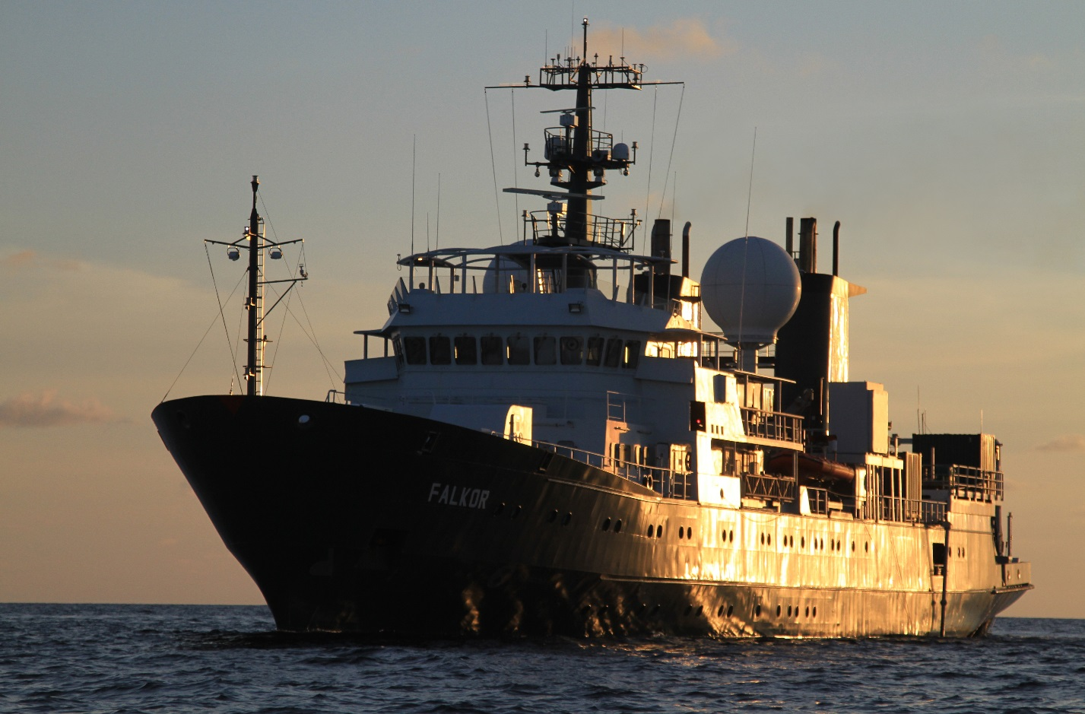
You never know what you could find!
On previous RV Falkor’s cruises, scientists have discovered new species.
There is still a lot to learn about the deep-sea environment and hydrothermal vent ecosystems.
You could witness an incredible discovery!
Better understanding of this environment
is essential in the face of developing ocean threats, like deep-sea mining.
Don’t forget to visit the Falkor in 360º!
http://schmidtocean.org/falkor-3/

Slide 13
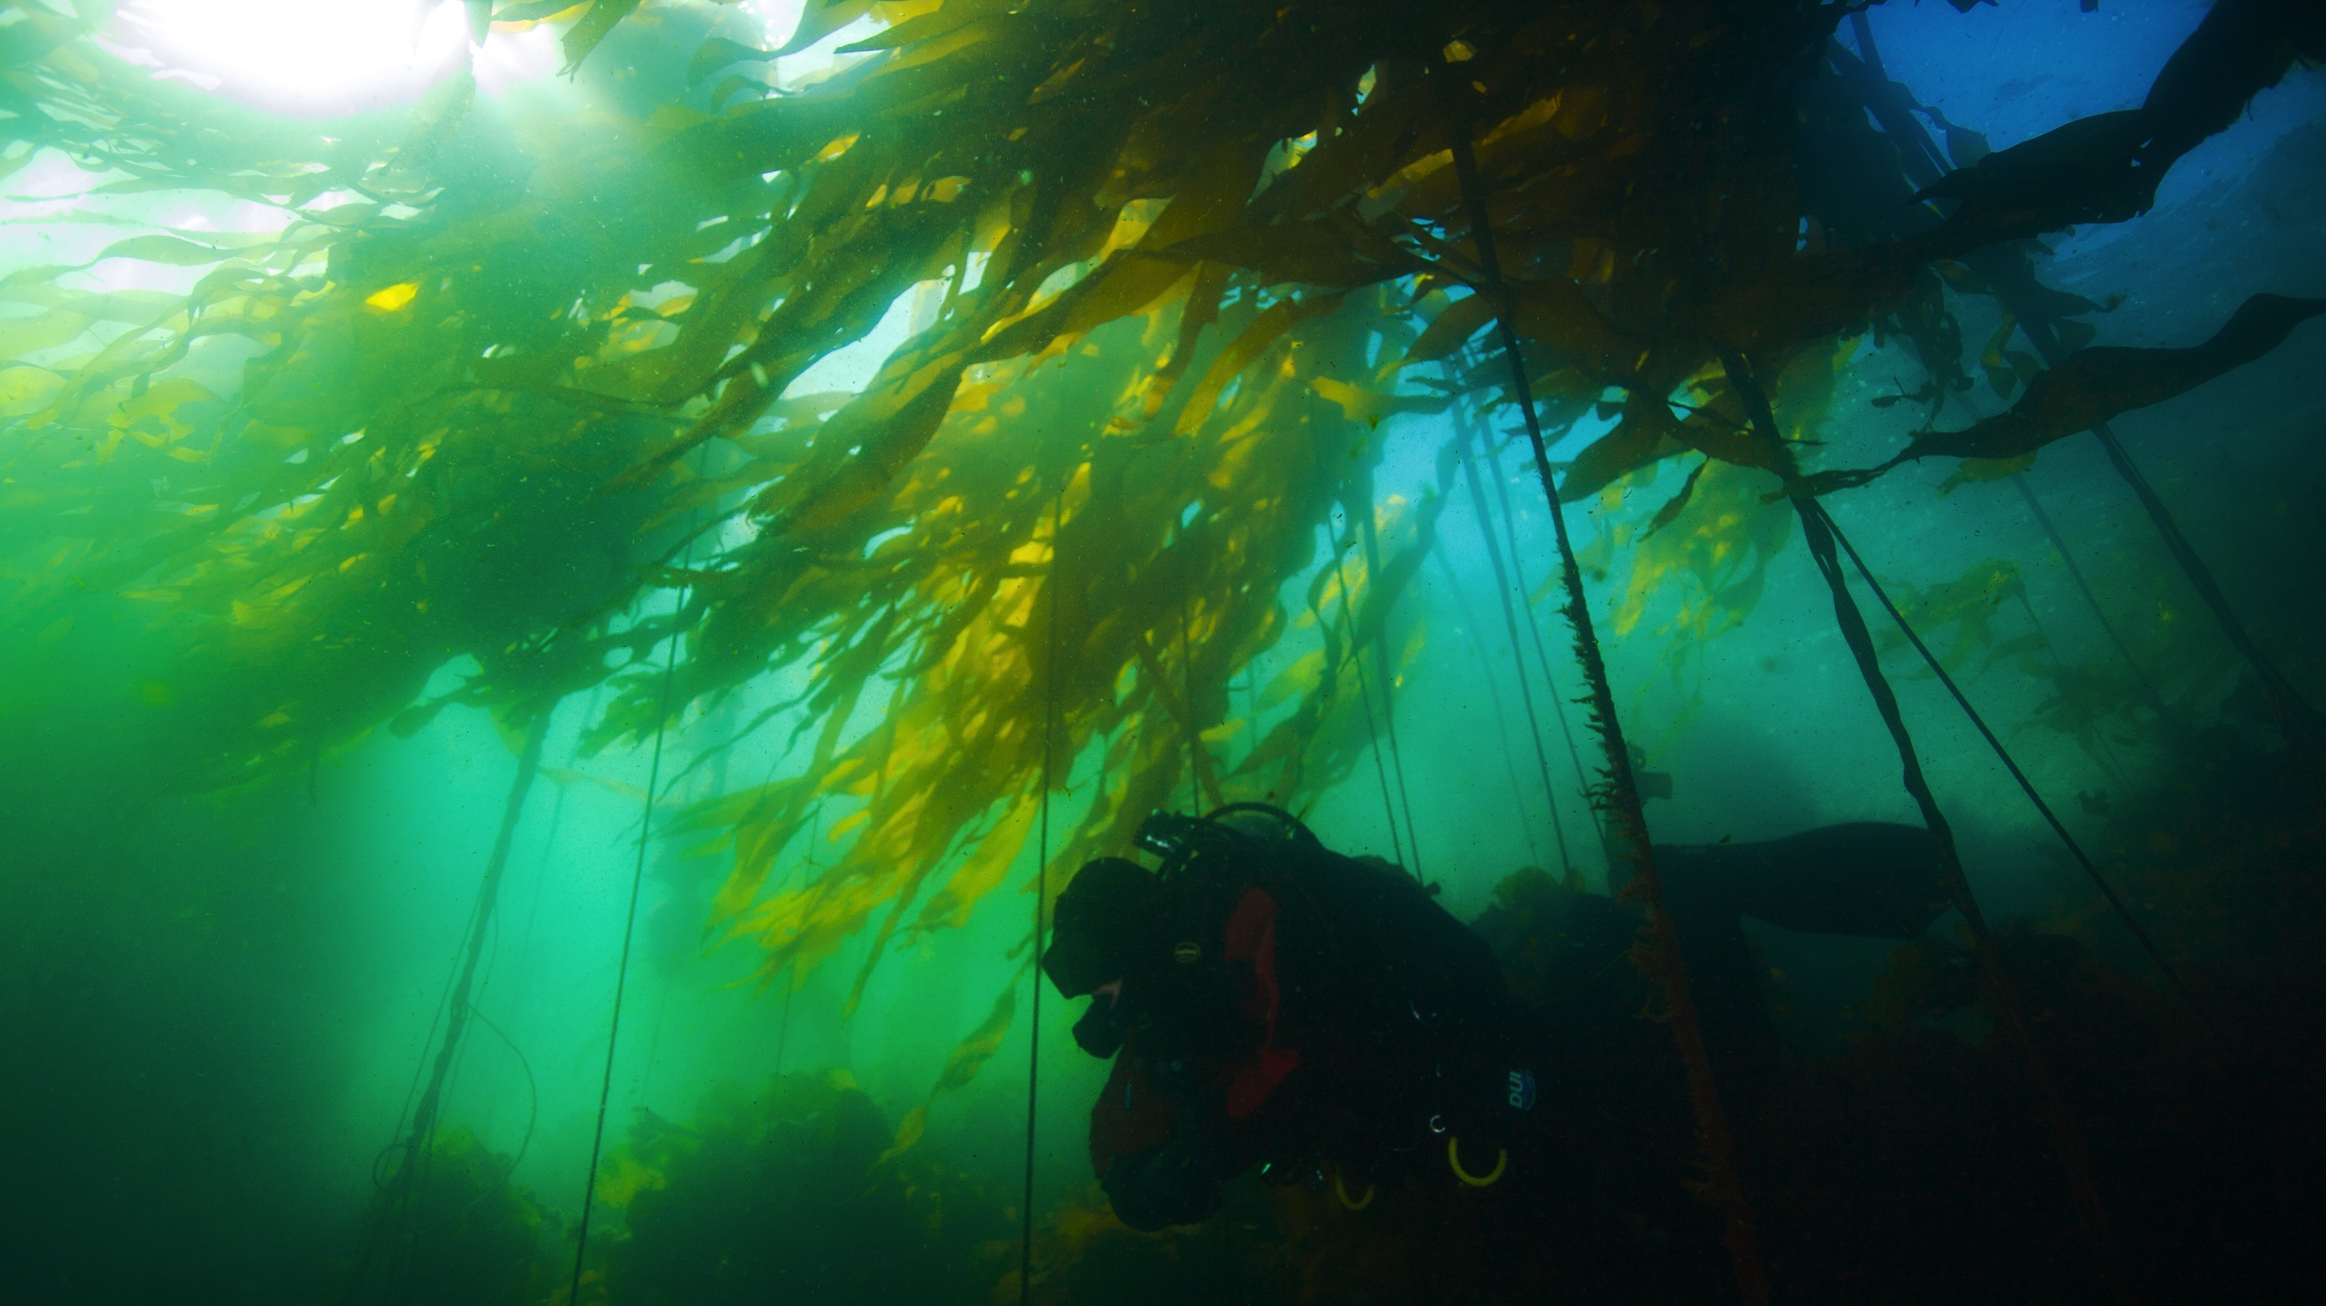
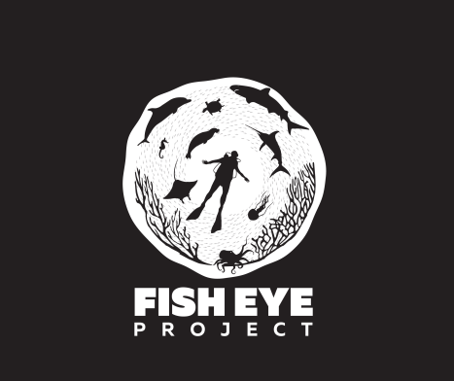
What’s Next? More Live Dives…
Visit FishEyeProject.Org and follow us social media
‘The Emerald Forest’ Live Dive, June 8, World Oceans Day
Wild Salmon Run Live Dive in September and more!
Subscribe to our YouTube Channel to access our upcoming Live Dives

